Slide 1
Claira Kauffmann
Akhila Ganti
Rachael Phillips
DATASCI266 - Final Project Presentation
Implementing BERT to Improve
Personal Health Mention Detection
Rachael Phillips
Claira Kauffmann
Akhila Ganti
Notes:
5 Minutes

Slide 2
Background & Motivation
Our goal is to improve results of the model and methodology developed in the 2019 paper, Figurative Usage Detection of Symptom Words to Improve Personal Health Mention Detection.
A real life motivation using Personal Health Mention detection occurred during COVID-19, when all interactions were brought online, many organizations tried to track the spread of the virus from social media, specifically Twitter.
Notes:
Rachael

Slide 3
Methods
1. Baseline CNN
3. Baseline BERT
Based off hyperparameters used in the 2019 research paper, Figurative Usage Detection of Symptom Words
A general purpose BERT model with default parameters/frozen layers
2. CNN + LSTM
4. Advanced BERT
To address the CNN’s shortcomings
BERT model pre-trained on medical-related text, the BioClinical BERT
Notes:
Rachael

Slide 4
Dataset
We will be using a data set from X, formerly Twitter, of 7,192 English Tweets that have been labeled.
~ 5837 Tweets across six diseases and conditions
Tweets were manually annotated with labels (self-mention, other-mention, awareness, non-health)
Class imbalance in the dataset as a whole
ID | Type | Example
0 | Figurative Mentions | Chuck Norris gives the sun cancer.
1 | Other Mentions | Nationalism is a cancer.
2 | Health Mentions | I'm a single mom to 4 kids and this is my third time facing cancer. I have Ewings Sarcoma, and there is no specialist anywhere near us.
Notes:
Rachael

Slide 5
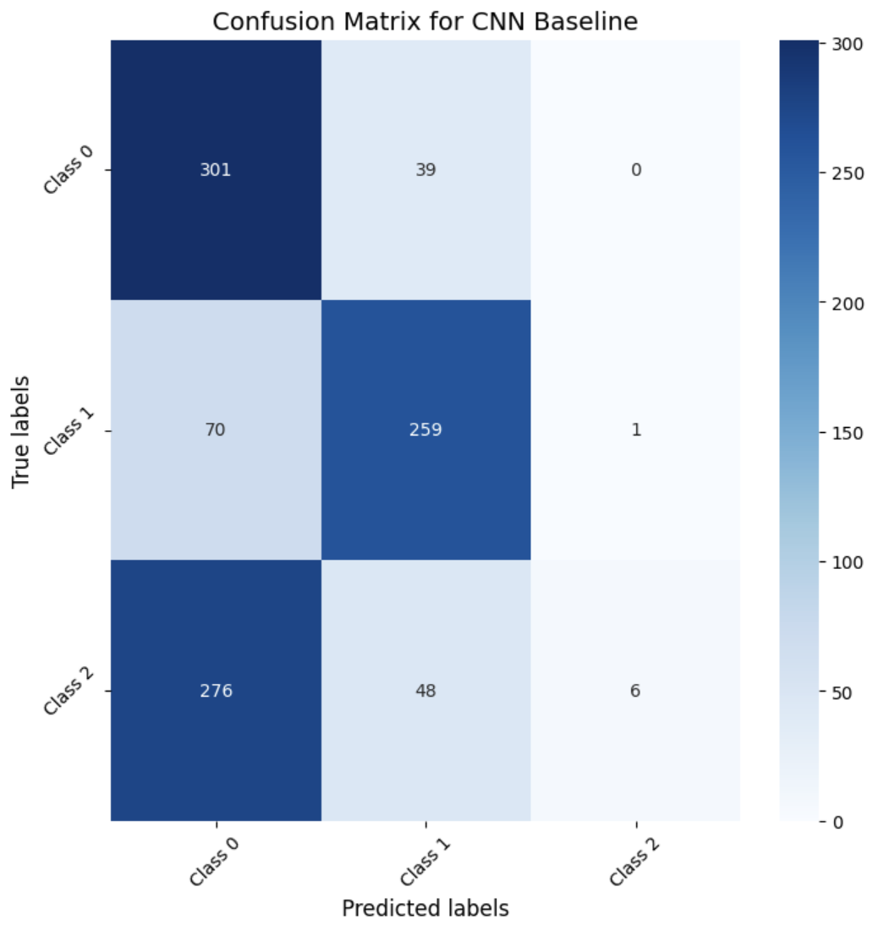
Results & Analysis - Baseline CNN
Misclassified examples:
i cannot stand when people where cologne or perfume. gives me a migraine
True label: 0 Predicted label: 1
Omg someone had a catastrophic stroke smoking 2 juul pods a day
True label: 2 Predicted label: 0
Original Paper’s F1 Score: 51.4
Baseline CNN F1 Score: 58.2
Notes:
Notes: Claira
Using the hyperparameters from the 2019 paper, we noted a seven percent increase. This could be due to improved gloVE embeddings. We saw that the baseline model struggled with class 2, often misclassifying it as figurative.
The baseline’s limited viewing window often resulted in misclassifications.
This underscored the need for a model with a longer memory span, leading us to explore LSTM.

Slide 6
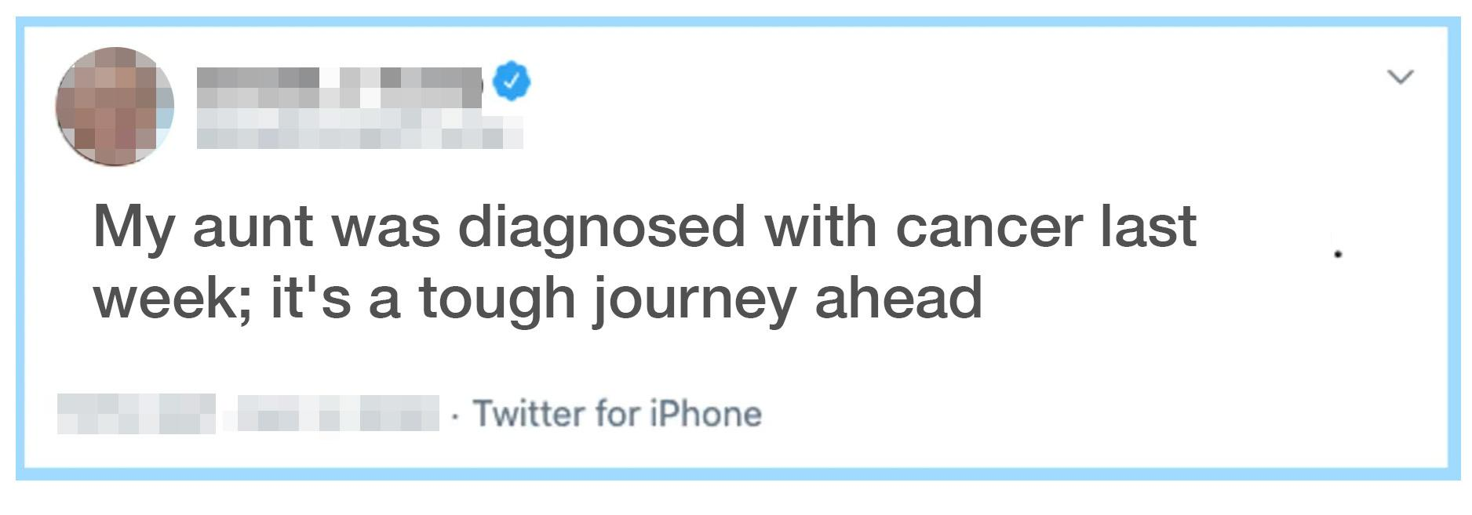
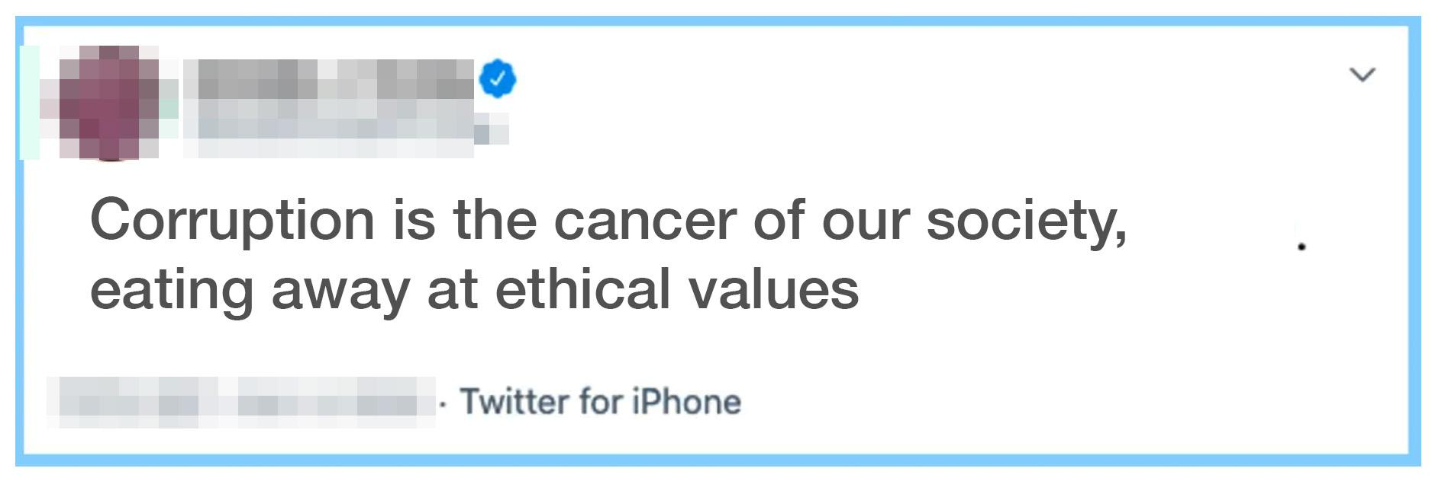
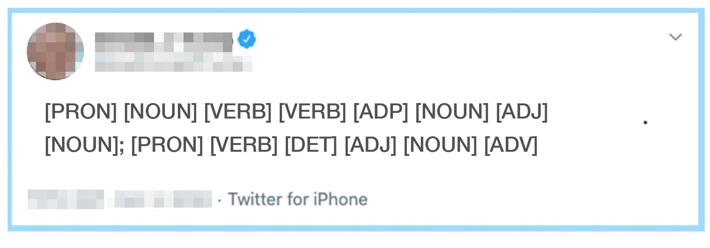
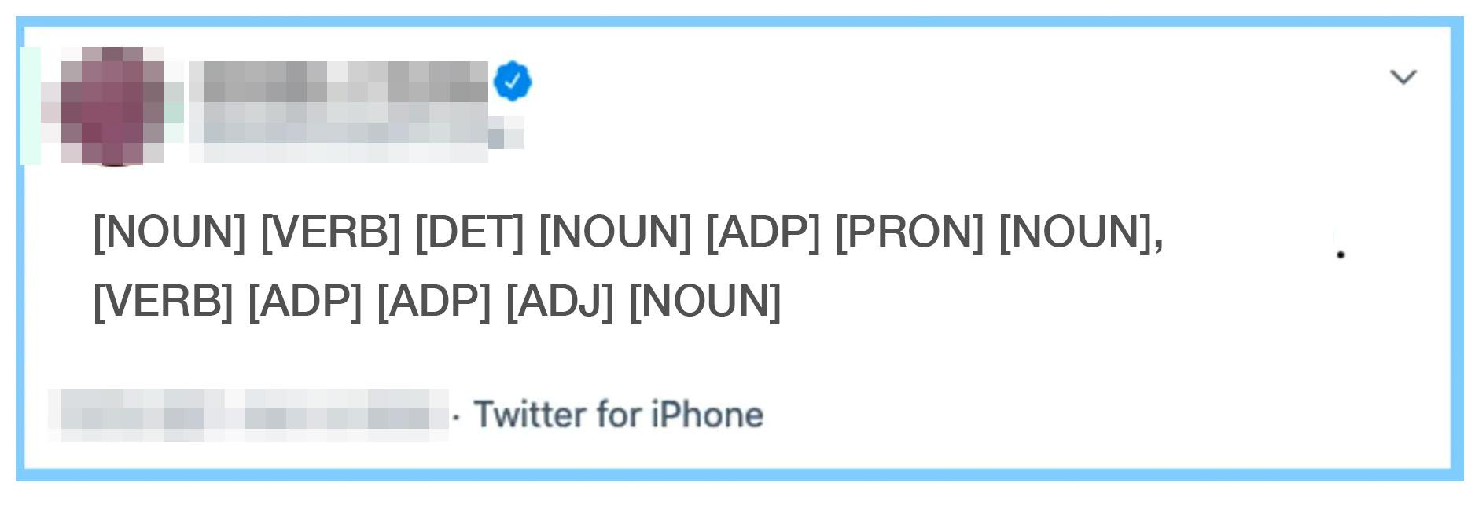
Results & Analysis - CNN + LSTM
Health-Related Tweet:
Figurative Usage Tweet:
CNN
spaCy
spaCy
output
LSTM
CNN+LSTM F1 Score: 78.1
CNN F1 Score: 57.1
Notes:
Notes: Claira
The LSTM immediately showed promise, with the F1 score jumping up by around 20 percent.
However, we did struggle with overfitting so we ran a few modifications to the input.
First, we masked out all the health terms in the tweets before training. We were happy to see the F1 score only dropped by a few percentage points, perhaps suggesting that the LSTM was picking up on syntactic structure differences.
To test this we used the spacY library to tag the words with part-of-speech, and trained the LSTM only on the part-of-speech of the tweets. Surprisingly, this performed only 5% below the LSTM model trained on the actual words.
Finally we combined the two models, allowing the CNN and LSTM each to do what they did best. This gave us our best F1 score of 78.1, just beating out the LSTM-only model but the added complexity perhaps is not worth it.
Though we made significant strides, we knew we needed to capture greater contextual meaning, which led us to BERT.

Slide 7
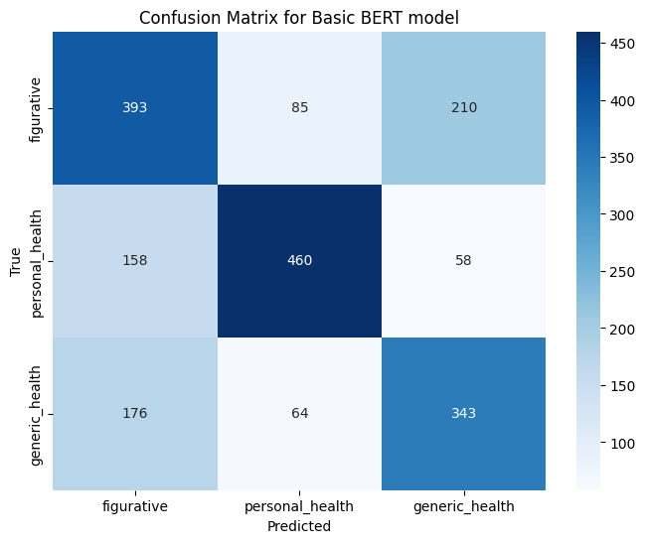
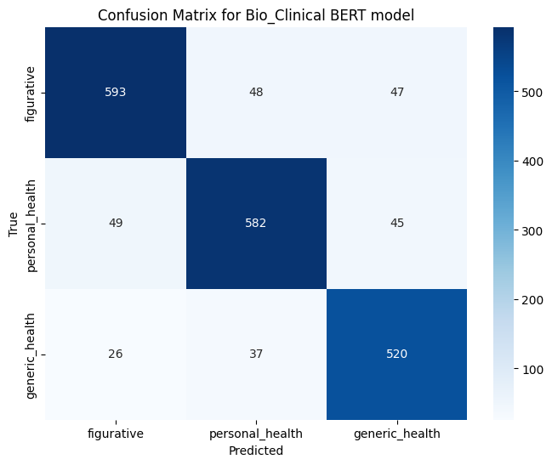
Results & Analysis - BERT models
Base BERT model F1 score: 0.60 compared to the Bio_Clinical BERT model F1 score: 0.87
Notes:
Results & Summary of Analysis
BERT - Akhila

Slide 8
Conclusion
We built upon a BERT model pre-trained on BioClinical data in order to improve Personal Health Mention Detection.
Compared to our baseline CNN model F1 score of 58.21, we were able to achieve with the BERT model F1 score of 0.87 (significant improvement of 49.46%)
Our main contribution is that we have developed and tested an approach to personal health mention detection that is more straightforward while maintaining a high accuracy score.
Finally, we have learnt a lot about building and training models while experimenting with fine tuning and hyper parameters adjustments.
Notes:
Results & Summary of Analysis
BERT - Akhila

Slide 9
Thank you!
Any questions?
Notes:
Results & Summary of Analysis

